Slide 1
Section 48 Laplace transforms
CHAPTER 9

Slide 2
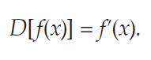
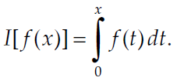
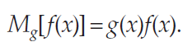
Section – 48
If the letter D is used to denote differentiation, then this transformation can be written as
Another important transformation of functions is that of integration
the operation of multiplying all functions by a specific function g(x):

Slide 3
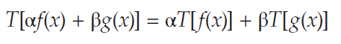
Section – 48
In each of our examples, the function on the right is called the transform of f(x) under the corresponding transformation.
A general transformation T of functions is said to be linear if the following relation holds for all admissible functions f(x) and g(x) and all constants α and β.

Slide 4
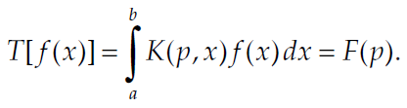
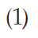

Section - 48
A class of linear transformations of particular importance is that of the Integral Transformations.
the general integral transformation is given by
The function K(p,x) is called the kernel of the transformation T, and it is clear that T is linear regardless of the nature of K.

Slide 5
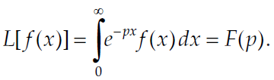
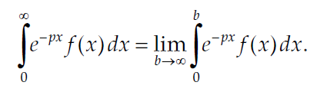

Section - 48
When a = 0, b = ∞, and K(p,x) = e^{–px}, we obtain the special case of (1) that concerns us—the Laplace Transformation L, defined by
The above exists only when following limit exists

Slide 6
More about Laplace transforms
Laplace transforms were named after Laplace who was a mathematician and astonomer who used a similar transform in his work on probability theory.
This theory was further developed by Heaviside, Lerch and Bromwich.
This technique finds applications in the analysis of electrical circuits.

Slide 7
Other fields where LT is used
Nuclear physics
Determining structure of astronomical object from spectrum
Statistical mechanics

Slide 8
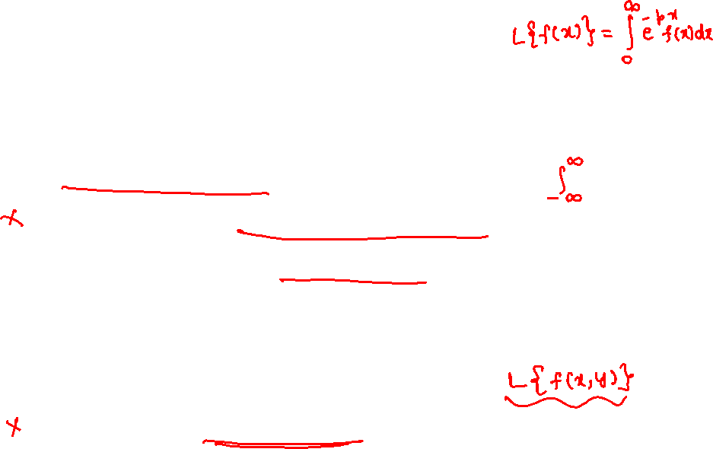
More info on LT
The definition of LT used here is termed as uni-lateral transform.
We have bi-lateral transform which is equivalent to probability moment- generating function. Finds applications in analyzing causal electrical circuits with sources with positive and negative time functions.
Recently, LT for 2D functions have been defined.

Slide 9
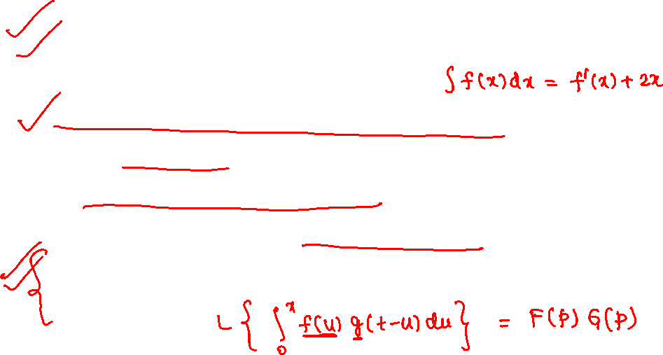
Why LT??
An ODE equation gets transformed into an algebraic equation.
Integral and integro- differential equations can be readily solved.
A PDE with n-independent variable gets transformed into a PDE with n-1 variables.
Convolution product becomes an ordinary product.

Slide 10
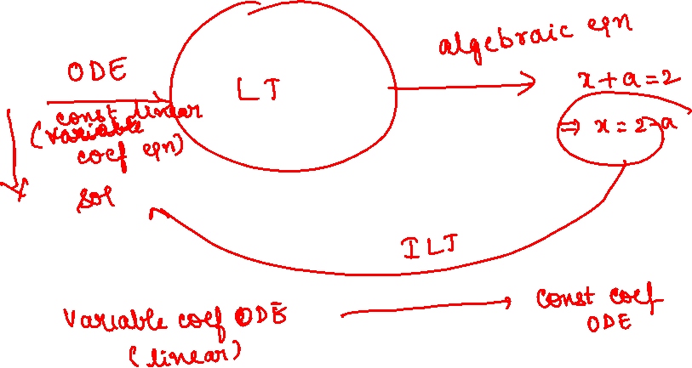

Slide 11
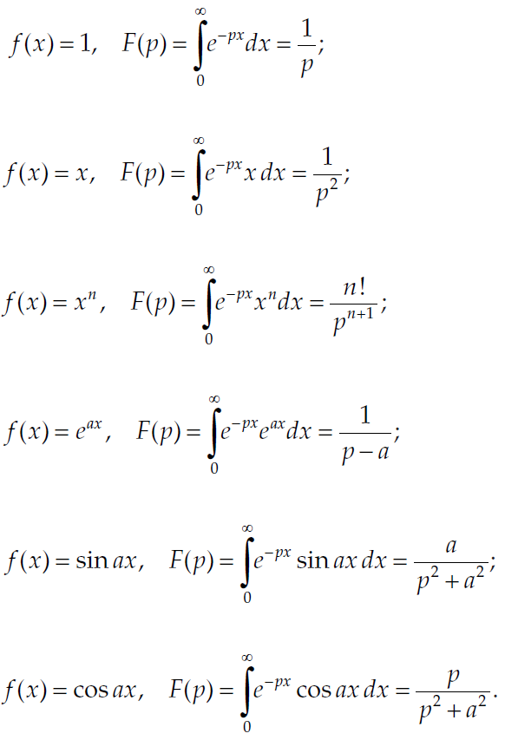
Section - 48
Examples

Slide 12
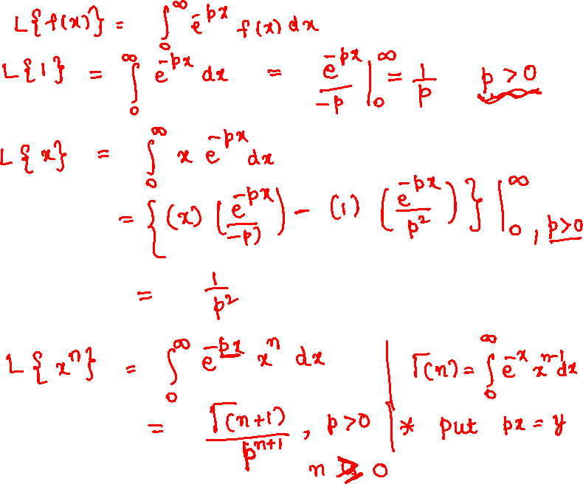

Slide 13
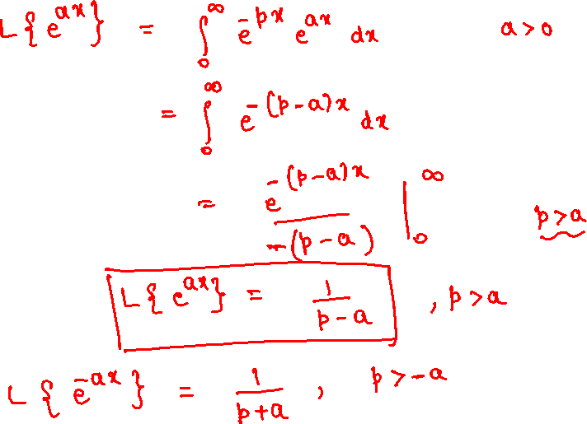

Slide 14
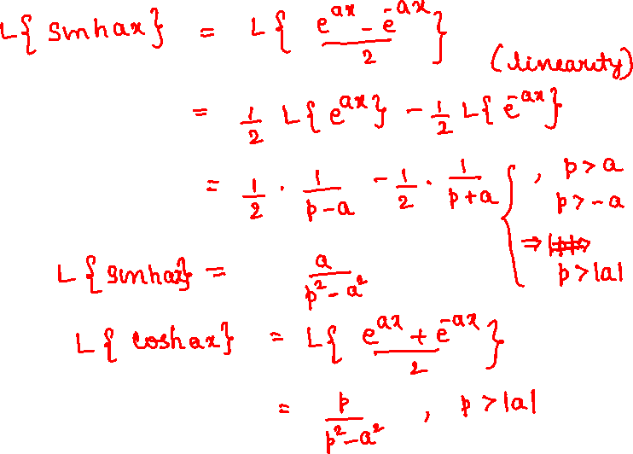

Slide 15
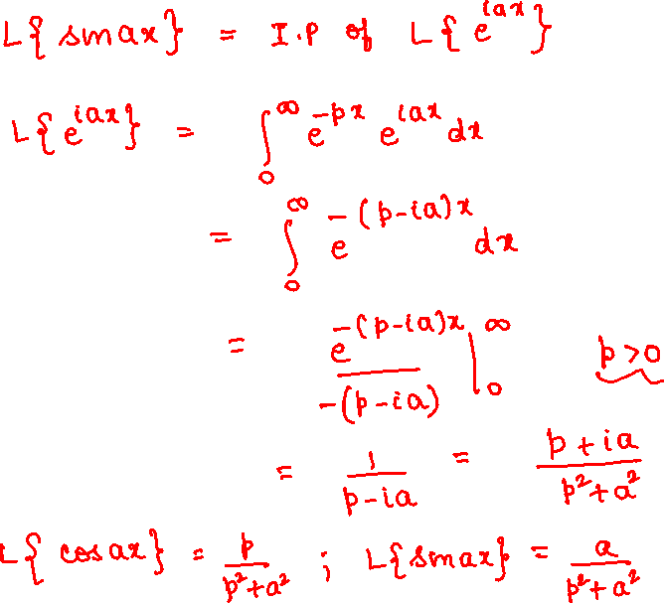

Slide 17
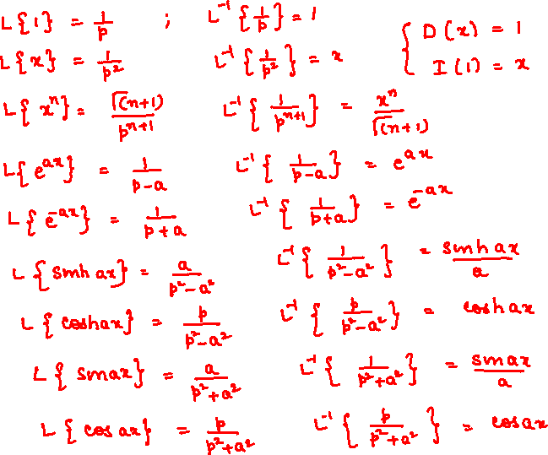

Slide 18
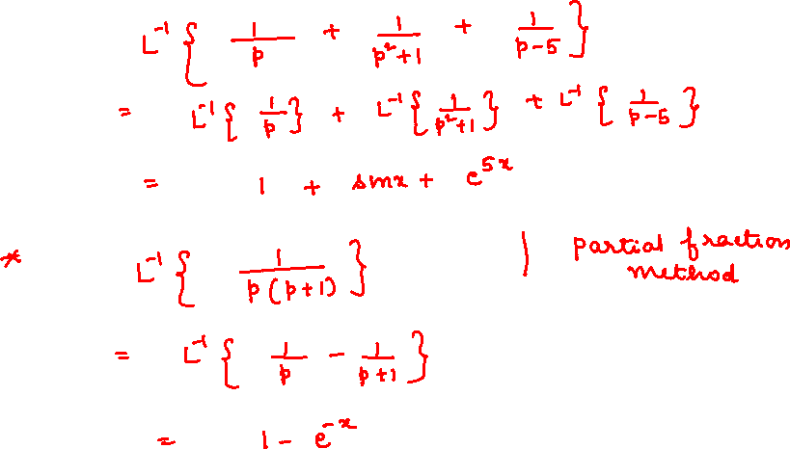

Slide 19
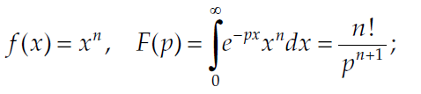
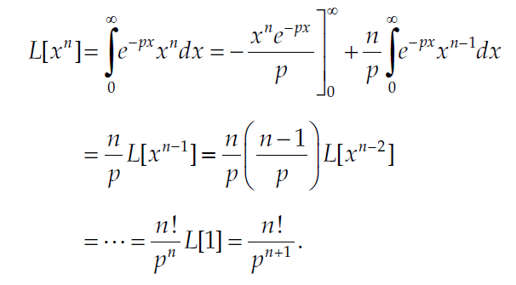
Section - 48
Solution for

Slide 20
Section - 48
As we stated above, the Laplace transformation L can be regarded as the special case of the general integral transformation (1) obtained by taking a = 0, b = ∞, and K(p,x) = e^{–px}. Why do we choose these limits and this particular kernel?

Slide 21
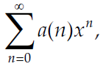
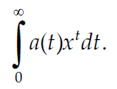
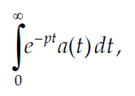
Section - 48
If we write a power series in the form
then its natural analog is the improper integral
We now change the notation slightly by writing x = e^{–p}, and this integral becomes

Slide 22
Section 48 problems
CHAPTER 9

Slide 23
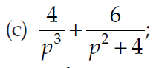
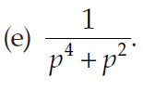
Section - 48

Slide 25
Section 49 A few Remarks on the theory
CHAPTER 9

Slide 26
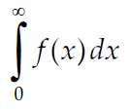
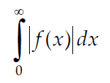
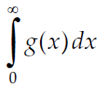
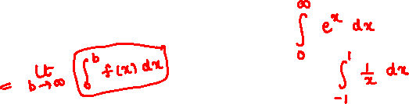
Section – 49 Existence of LT for a function
The integral is said to converge whenever the integral converges, and in this case is said to converge absolutely. Then, there exists a function g(x) such that |f(x)| ≤ g(x) and converges (this is known as the comparison test).

Slide 27
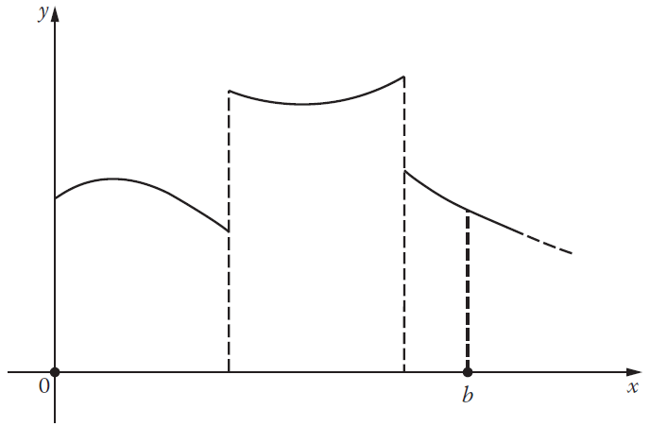
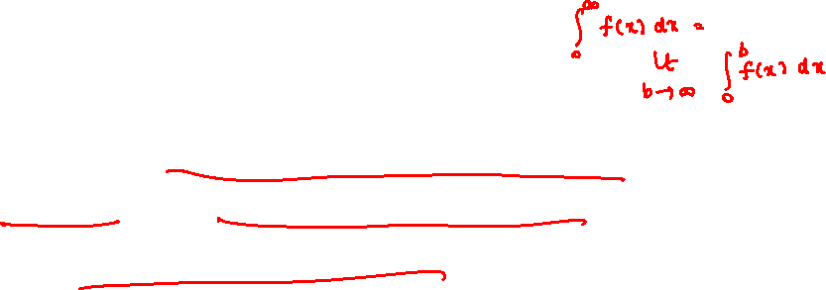
Section - 49
f(x) is continuous over every finite interval 0 ≤ x ≤ b, except possibly at a finite number of points where there are jump discontinuities.

Slide 28
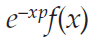
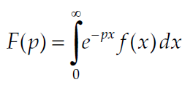
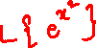
Section - 49
If f(x) is piecewise continuous for x ≥ 0, then the only remaining threat to the existence of its Laplace transform is the behaviour of the integrand for large x.

Slide 29
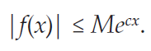
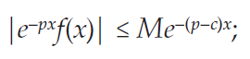
Section - 49
to make sure that f(x) does not grow too rapidly—we shall further assume that f(x) is of exponential order.
This means that there exist constants M and c such that

Slide 30
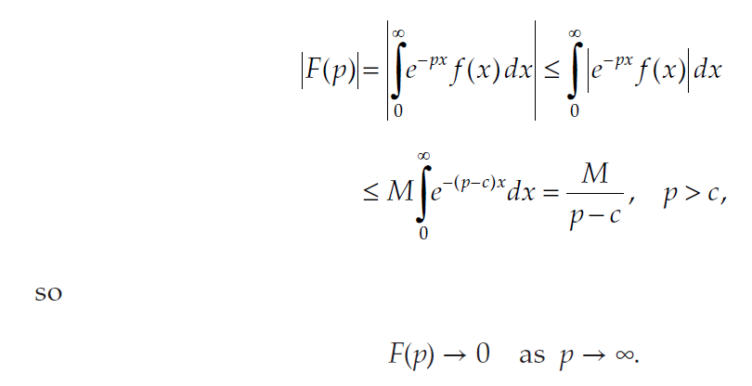
Section - 49
since the integral of the function on the right converges for p > c, the Laplace transform of f(x) converges absolutely for p > c.

Slide 31
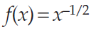
Section - 49
The function has an infinite discontinuity at x = 0, so it is not piecewise continuous, but nevertheless its integral from 0 to b exists; and since it is bounded for large x, its Laplace transform exists.

Slide 32
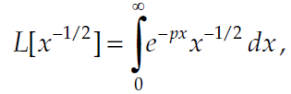
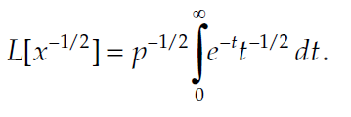
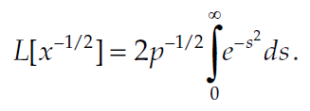
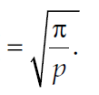
Section - 49
the change of variable px = t gives
change of variable, t = s2, leads to

Slide 33
Section 49 problems
CHAPTER 9

Slide 34
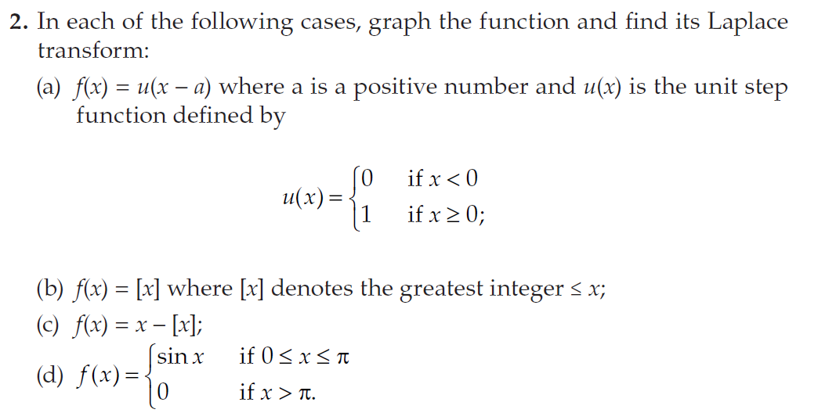
Section - 49

Slide 35
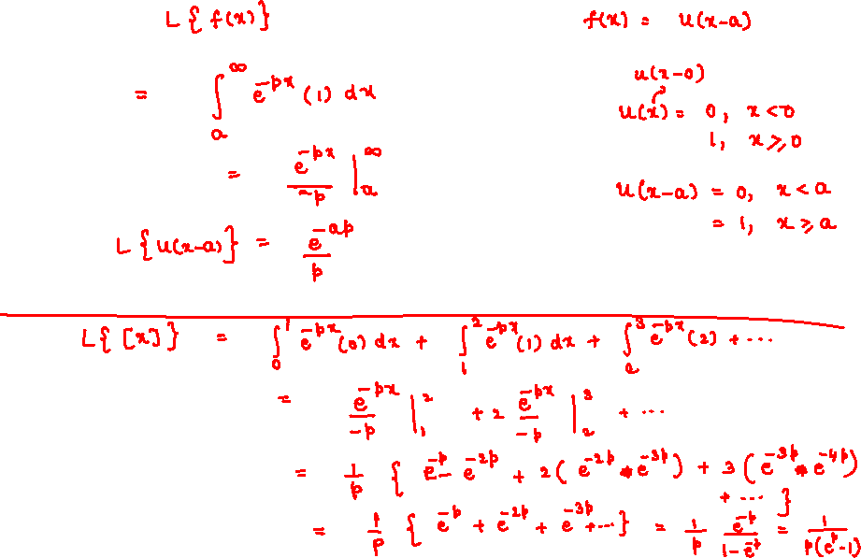

Slide 36
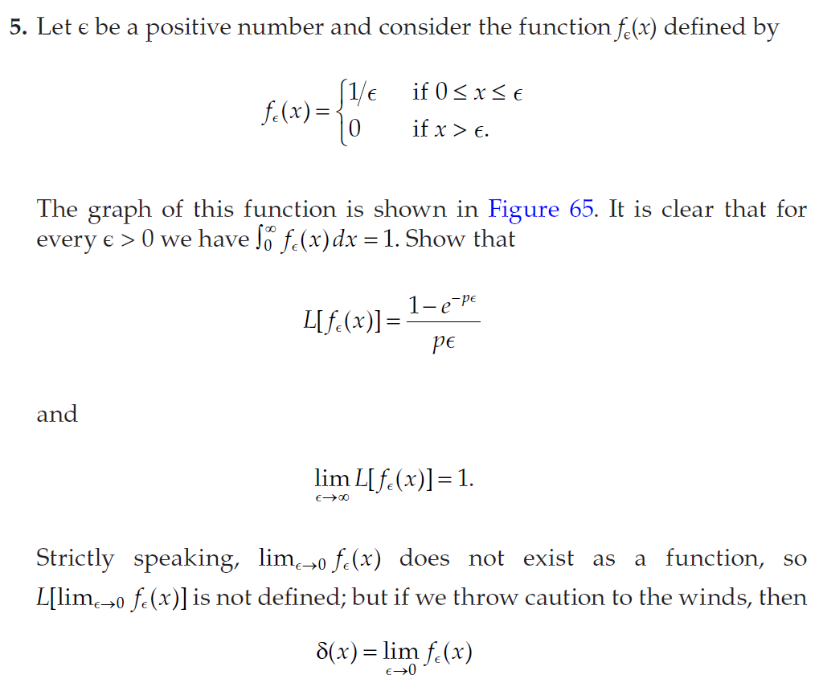
Section - 49

Slide 37
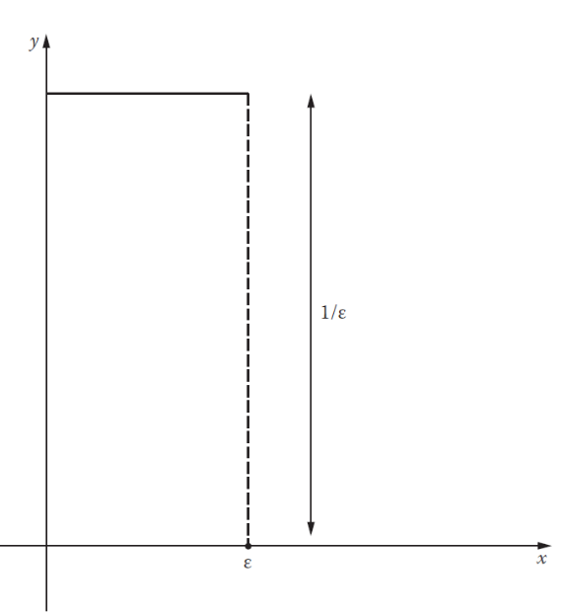
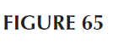
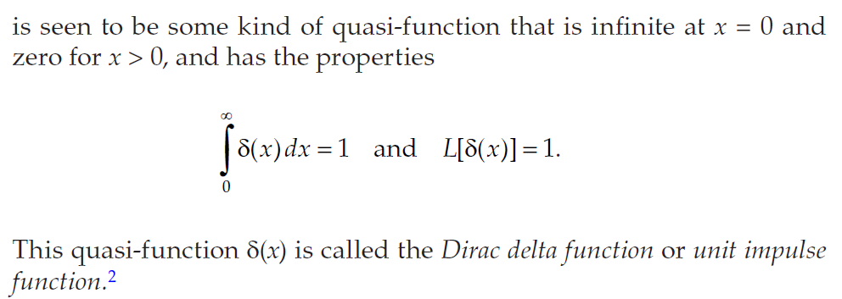
Section - 49

Slide 38
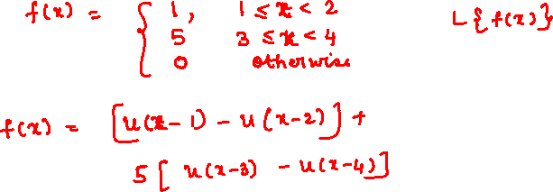

Slide 39
Section - 48
As we stated above, the Laplace transformation L can be regarded as the special case of the general integral transformation (1) obtained by taking a = 0, b = ∞, and K(p,x) = e^{–px}. Why do we choose these limits and this particular kernel?

Slide 40
Section - 48
If we write a power series in the form
then its natural analog is the improper integral
We now change the notation slightly by writing x = e^{–p}, and this integral becomes

Slide 41
Section 48 problems
CHAPTER 9

Slide 42
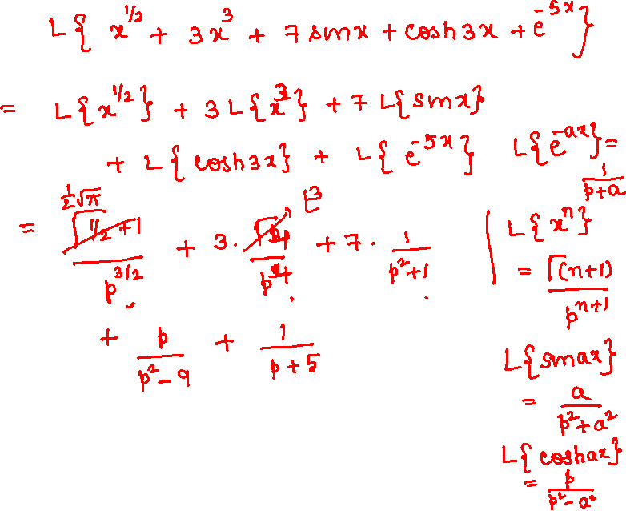

Slide 43



Section - 48

Slide 44
Section 50 Applications to differential equations
CHAPTER 9

Slide 45



Section - 50
Shifting property of Laplace transforms

Slide 46





Section - 50
Example
Example

Slide 47
Section 50 problems
CHAPTER 9

Slide 48


Section - 50

Slide 49


Slide 50


Slide 51


Slide 52


Slide 53


Slide 54


Slide 55


Slide 56


Slide 57

Section - 50

Slide 60
Section 51 derivatives and integrals of laplace transforms
CHAPTER 9

Slide 61





Section - 51
Consider the general Laplace transform formula
By differentiating

Slide 62


Section - 51
more generally,
Example :

Slide 63


Slide 65


Slide 67




Section - 51
If we apply (1) to a function y(x) and its derivatives

Slide 68



Section - 51

Slide 69
Section 51 problems
CHAPTER 9

Slide 70

Section - 51

Slide 71


Slide 72


Section - 51

Slide 73

Section - 51

Slide 77
Section 52 convolutions
CHAPTER 9

Slide 78
Section 52 problems
CHAPTER 9

Slide 79

Section - 52

Slide 80


